Slide 1
Abstract algebra ch 22 finite fields

Slide 2
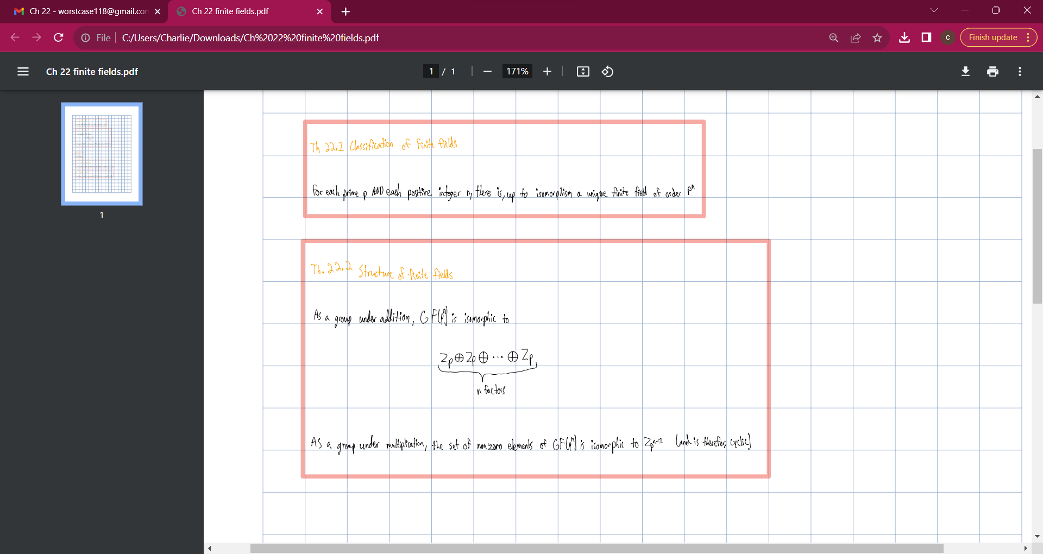

Slide 3
